Slide 1
PHOTOPHYSICAL PROCESSE OF
EXCITED STATE DEACTIVATION
Dr. Sreenath K
Asst. Professor, Dept of Chemistry
NSS College Pandalam

Slide 2
Modes of dissipation of energy
Non radiative deactivation Radiative deactivation
(1) Vibrational relaxation (1) Fluorescence
(2) Internal conversion (2) Phosphorescence
(3) Intersystem crossing

Slide 3
Vibrational relaxation
S₁
hν
S₀
Ground state
Excited state
Equilibrated Excited state
In liquid phase vibrational relaxation is very rapid ( 10⁻¹³ to 10⁻¹² S )

Slide 4
Internal conversion
S₂
S₁
S_{O}
“Internal conversion is a non radiative transition between an excited state
and a state of lower energy of the same multiplicity”

Slide 5
Competition between Internal conversion and Florescence
Example : Azulene and its derivatives

Slide 6
How Sn (n =2,3,….) levels are formed ?
Electronic transition from the HOMO to an orbital of energy
greater than LUMO
Electronic transition from an orbital of lower energy than HOMO
to the LUMO level
Example:Benzophenone
π∗
n
π
S₀
S₁
S₂

Slide 7
Internal conversion between S_{o} and S₁ is almost absent
(1) Important energy difference between S_{o} and S₁
(2) Poor overlap of vibrational levels of these two state
The rate of internal conversion between the different
triplet state is of the same order of magnitude
as that of excited singlet state

Slide 8
Intersystem crossing
S₁
T₁
A non radiative analogue of IC
Between states of different multiplicity
Forbidden according to Wigners rule
(1) If spin orbit interaction is possible
(1) If singlet / triplet energy difference is small
ISC is slower than IC
For S₁-T₁ 10⁻¹¹-10⁻⁶ S
T₁-S₀ 10⁻⁷-10 S
Nearly all bimolecular photochemical reactions occur from the
lowest triplet state (T₁)
ISC
S₀

Slide 9
Luminescence
Radiative deactivation
Fluorescence
Phosphorescence
S₁
T₁
ISC
hν
hν
S₀
Emission spectra
Variation of emission intensity as a functoin of wavelength or frequency

Slide 10
Mirror Image Rule
If the equilibrium configuration of the ground state and the excited state
are identical
If vibrational levels of the two states are similar
Example : Perylene

Slide 11
Why mirror image ?

Slide 12
Exceptions to Mirror Image
(1) Different geometric arrangements of nuclei in the excited state
Example : p-terphenyl
(2) Excited state reactions
Example : Anthracene

Slide 13
(3) Excimer formation
hν
¹M*
M
¹M* +
M
M*)
¹(M……
Example :Pyrene

Slide 14
Delayed fluorescence
A long fluorescence life time or a temperature dependent intensity of emission
may signal a delayed fluorescence
Such fluorescence emission is observed after a very rapid ISC (S₁-T₁)
then againS1 is formed by
(1) Either triplet-triplet annihilation (T₁ + T₁ S₀ + S₁ )
(2) Thermal activation from (T₁)

Slide 15
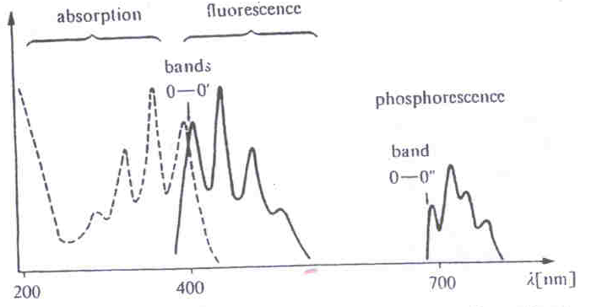
Phosphorescence
It is a slower phenomenon than fluorescence (10⁻⁷-10S)
Large stock shift
Life of ³(nπ*) excited state is shorter than that of an ³(ππ*)excited state
Example :The life time of Acetone triplet, which is a pure (nπ*),
is 500 time shorter than that of naphthalene triplet,
which is purely (ππ*)
The rate of deactivation of the triplet state by collision in the medium
is generally greater than rate of phosphorescence emission
n the emission band the frequency of 0-0’ line of shortest wave length
is used to calculate the energy of the triplet state

Slide 16
Characteristics of Fluorophore
Quantum yield
Life time
Quantum yield
Quantum yield (Q) =
No : of emitted photons
No: of absorbed photons
K _{r}
K _{r}
=
Rate of radiative
decay
=
( 1 )
K _{r}
+
K _{n r}
K _{nr}
=
Rate of non
radiative decay
If
K _{nr}
<<<<
K _{r}
Q ~
1
( Rhodamine )
~
Q =
1
( Stokes lose )
/

Slide 17
Life Time
Rate of deactivation is propotional to the concentration of the excited state
-d [ES]
α
[ES]
d t
-d [ES]
= K
[ES]
d t
K =Rate constant of deactivation
-d [ES]
= K
[ES]
d t
-d [ES]
= K
d t
[ES]
On integration
-In [ES] = Kt + C
When t = 0, [ ES ] = [ ES ]_{0,} then C = -In [ES ]₀
-In [ES] = Kt - In [ES ]₀
In [ES] = -Kt +In [ES ]₀
[ ES ] = [ES ]₀ e^{-Kt}

Slide 18
[ ES ] = [ES ]₀ e^{-Kt}
[ ES ]₀
= e ^{Kt}
[ ES ]
In [ ES ]₀
= Kt
[ ES ]
When
[ ES ] = [ ES ]₀
e
Kt = 1
t = 1/K
τ =1/K
τ Average life time
=
“ We can define life time (τ ) as time necessary for the concentration
of excited molecules to diminish to 1/e of its initial value “

Slide 19
τ
1
=
Σ K _{i}
τ
1
=
(2)
K_{r} + K_{nr}
Intrinsic or Natural life time
τ_{n}
1
K _{r}
=
(3)
Q
=
( 1 )
K_{r}
K _{r}
+
K _{n r}
On comparing equations (1), (2), (3).
Q = K _{r} τ
τ =
Q
(4)
K _{r}
On comparing equations (4), (3).
τ = Q τ_{n}
τ
τ_{n} =
Q

Slide 20
Thanks

